Slide 1
DATA SCIENCE

Slide 2

Department of Computer Science and Engineering
Jawaharlal Nehru Engineering College, Aurangabad
( Affiliated to Dr. B.A.Technical University.Lonere )
( Year 2019-20 )
FY/SY/TY INTERNSHIP
Presentation
Data science
Submitted by
Gayatri Modani
(206205)
Under Guidance of
Charudatt mane sir

Slide 3
Topic covered in course
Introduction to data science and its application
Basic python
Understanding statistic
Predictive modelling

Slide 4
Introduction to data science
Data Science is a blend of various tools, algorithms, and machine learning principles with the goal to discover hidden patterns from the raw data.
Data science, or data-driven science, uses big data and machine learning to interpret data for decision-making purposes. Data science uses techniques such as machine learning and artificial intelligence to extract meaningful information and to predict future patterns and behaviours.

Slide 5
Application of data science
There are multiple application of data science It is used in health care sector, internet searching, speech recognisation, airplane route planning, advertisement, etc.
By using data science to gain insights into your customers' companies can improve marketing strategies.

Slide 6

Example to understand data science

Slide 7
Basic python for data science
1.Introduction to python 9.understanding standard
2.Understanding operators libraries in python.
3.Variables and data types 10.reading csv file in
4.Conditional statement python.
5.Looping constructs 11.data frames and its
6.Function basic operation.
7.Data structure 12.indexing data frames
8.Lists and dictionary

Slide 8
Pandas is python data analysis is toolkit for reading, filtering, manipulating and exporting data.
Pandas can help you read data from different types of file format such as csv, MS excel, HTML etc. we use read_csv to read csv files in pandas.
A Data frame is a two-dimensional data structure, i.e., data is aligned in a tabular fashion in rows and columns.

Slide 9
Statistic in data science.
Different type of statistic are:
1. Descriptive statistics uses the data to provide descriptions of the population, either through numerical calculations or graphs or tables.
Inferential statistics makes inferences and predictions about a population based on a sample of data taken from the population in question.

Slide 10
Types of variables
Continuous variables: they have value that having continuous numerical value
Categorical variables:
1. Nominal: variables having categories
2.ordinal variable: variables having categories with in order.

Slide 11
Central limit theorem
If we take means of random samples from a distribution and we plot the means, the graph approaches to a normal distribution when we have taken sufficiently large number of such samples.
The theorem also says that the mean of means will be approximately equal to the mean of sample means.

Slide 12
Zero score
The distance in terms of number of standard deviations, the observed value is away from the mean, is the standard score or the Z score.
Observed value = μ + z σ
μ is the mean and σ is the standard deviation.

Slide 13
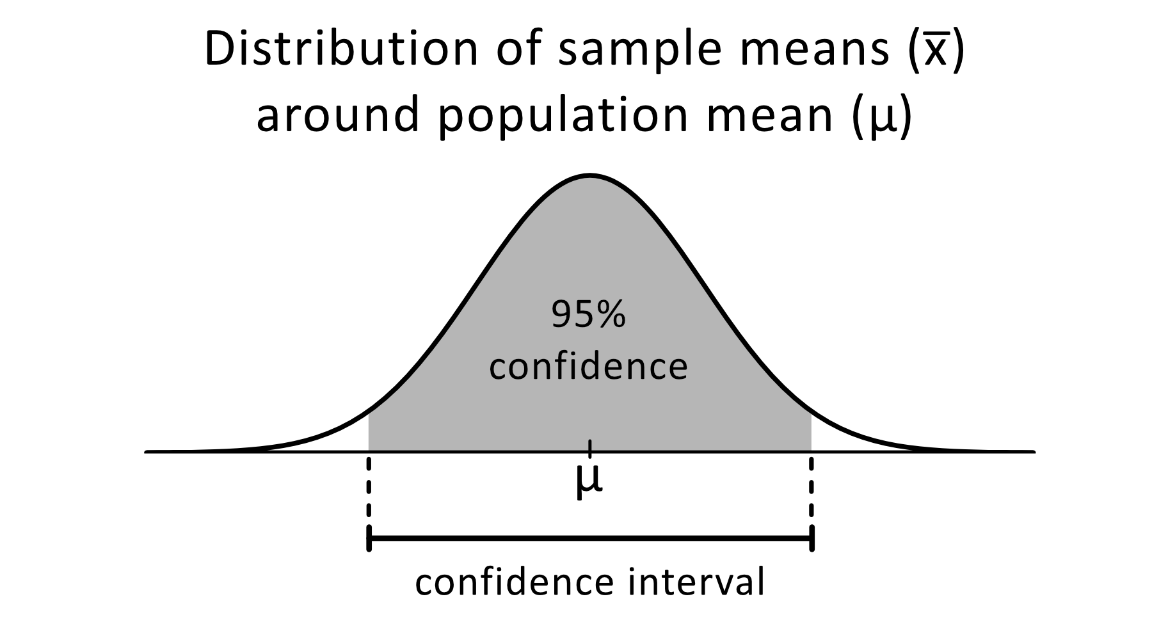
Confidence interval and margin of error
_{Confidence Interval}
The confidence interval is a type of interval estimate from the sampling distribution which gives range of values in which population statistics may lie.
_{Mathematical formula:}
Confidence Interval = x̄ ± zα/2(σ/√n)
σ= Std. Deviation z= Value for desired confidence level.
n z= Value for desired confidence level.
Margin of error is on the either side of the mean . It can be both positive and negative.

Slide 14
Hypothesis testing
Null Hypothesis can be that the sample statistic to be equal to the population statistic or that the intervention doesn’t bring any difference to that sample. We cannot accept the null hypothesis, only reject it to fail to reject it.
Alternate Hypothesis is basically negates that the null hypothesis or says that the intervention brings a significant difference to the sample, or that the sample is significantly different from the population

Slide 15
Predictive modelling
Predictive modelling is a process that uses data and statistics to predict outcomes with data models. It is use of past data and other attributes to predict future using data.
Stages of Predictive Modelling-
Problem Definition.
Hypothesis Generation.
Data Extraction/Collection.
Data Exploration/Transformation.
Predictive Modelling.
Model Deployment/ Implementation.

Slide 16
Data exploration or transformation.
There are different steps to be followed.
1.reading data : reading data from file using read_csv, size of data, top 5 observation using head() command.
2.variable identification: identifying dependent and independent variable and at the same time we differentiate continuous and categorical variable.
3. univarite analysis
4. bi-variate analysis
5.missing value
6. outlier treatment
7.variable transformation

Slide 17
Univariate analysis for continuous variable
What do we look for ?
1.Central Tendency and Dispersion - mean, median, standard deviation
2.Distribution of variable - Symmetric/ Right Skewed/ Left Skewed
3.Presence of Missing values
4.Presence of Outliers
How to perform Univariate Analysis ?
1.Tabular Methods - Mean, Median, Standard Deviation and missing values.
2.Graphical methods - Distribution of variable, Presence of Outliers.

Slide 18
Univariate analysis for categorical variable
What we look foe in categorical univariate analysis:
1.Count:absolute frequency of each category in categorical variable
2.Count%: proportion of different categories in categorical variable expressed in %.
How do we do it ?
1.Tabular methods- Frequency tables.
2.Graphical Methods- Bar plots.

Slide 19
Bi- variate analysis
It helps in prediction. [ when two variable are associated one may be used to infer the other.]
Continuous - Continuous
  Scatter Plot
  Find r (correlation coefficient)
Categorical - Continuous
  Bar Plot
  T-Test
Categorical - Categorical
  Two - Way Table
  Chi - Square Test

Slide 20
Missing value and outlier treatment
missing completely at random(MCAR): when missing value have no relation with variable in which missing value exits or any other variable in data set.
Missing at random(MAR):missing value have no relation with variable in which missing value exits but have realtion with other varibales other than the variable in missing value exits.
Missing not at random(MNAR): when missing value have relation with variable in which missing value exits.
How to deal with missing value:
Imputation
2.deletion

Slide 21
Model building
Algorithm selection: We select the algorithm based on whether the variable is dependent or not.
Training model : It is a process to learn relationship/correlation between independent and dependent variable with the help of test and train datasets.
Prediction : It is a process to estimate / predict dependent variable of test data set by applying model rules.

Slide 22
Work done
Project on Problem Statement provided
Regular Intermediate tests after couple of videos
Module Tests and Assignments at the end of each module.
Implementation of Concepts learnt on Jupyter Notebook
Final Test at the end of all the 4 Modules.

Slide 23
conclusion
Why Data Science ?
Data creates magic.
Industries need data to help them make careful decisions.
Data Science churns raw data into meaningful insights.
A Data Scientist helps the company in the right direction.

Slide 24
Thank you

